Slide 1
A Simple Pairing Model
John Bower
Nuclear Structure
05/01/2016

Slide 2
Outline
Motivation
Development
Tests
Results
Future

Slide 3
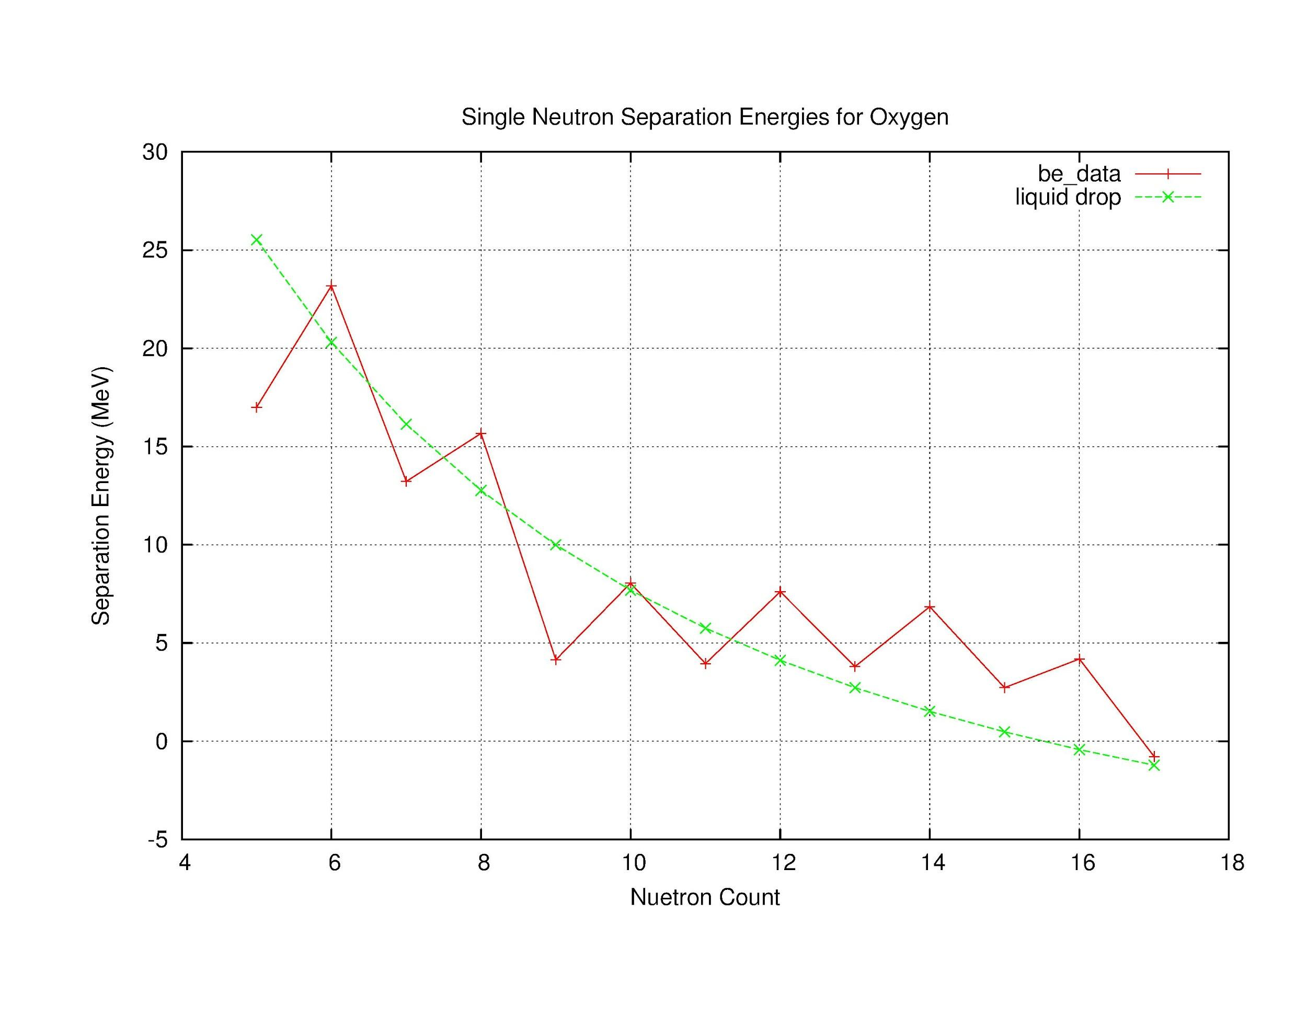
Motivation
Pairing Effects in Nuclei
Liquid Drop not enough
Even counts more bound than odd counts

Slide 4
Motivation
Model Reality
Develop a mindset and methodology
systematic thoroughness
efficiency

Slide 5
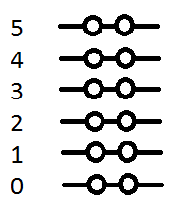
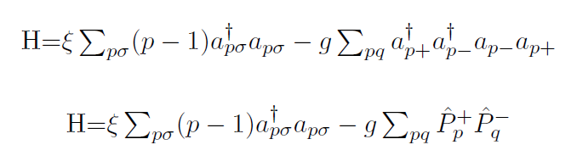
Development
Develop Hamiltonian

Slide 6
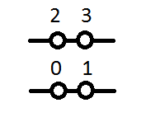
Development
Develop Hamiltonian
Construct States
00 00 → 10 00, 01 00, 00 10, 00 01
→ 11 00, 10 10, 10 01, 01 10, 01 01, 00 11
→ 11 10, 11 01, 10 11, 01 11
→ 11 11

Slide 7

Development
Hamiltonian
Construct States
Encode
How many states do we need?
11 00 → 6
How to store this information?
11 00 → yes yes no no
10 01 → yes no no yes

Slide 8
Development
Hamiltonian
Construct States
Encode
How do we prescribe annihilation/creation operators?
“a[i]” and “a⁺[j]”
How do we store information from such an operation?
Phase? Energy? New State? Old?

Slide 9
Development
Hamiltonian
Construct States
Encode
Store test, phase, new state
a⁺[3] |00 10 11 00> → b |00 11 11 00>
b = (-1)⁰ ⁺ ⁰ ⁺ ¹ = (-1)¹ = -1
a⁺[3] |00 10 11 00> → - |00 11 11 00>

Slide 10
Development
Hamiltonian
Construct States
Encode
Store only new state
a⁺[4]a⁺[5]a[1]a[0] |11 10 00 00> → b |00 10 11 00>
b = (-1)¹ ⁺ ¹ ⁺ ⁰ ⁺ ⁰ = (-1)² = 1
a⁺[2]a⁺[3]a[1]a[0] |11 10 00 00> → |00 10 11 00>

Slide 11
Development
Hamiltonian
Construct States
Encode
Test two states:
< n | H | m > = < n | E_{nm} | k > = E_{nm} <11 10 | 11 01>
(1 XOR 1) + (1 XOR 1) + (1 XOR 0) + (0 XOR 1) = result = 2
(result > 0) → false

Slide 12

Development
Hamiltonian
Construct States
Encode
Broken Pairs
From the form of the hamiltonian, there can be no mixing between states with different numbers of broken pairs, so for speed we form the hamiltonian as block-diagonal.

Slide 13
Development
Hamiltonian
Construct States
00 10 00 00 11 11 11 01 ...
Encode
Broken Pairs

Slide 14
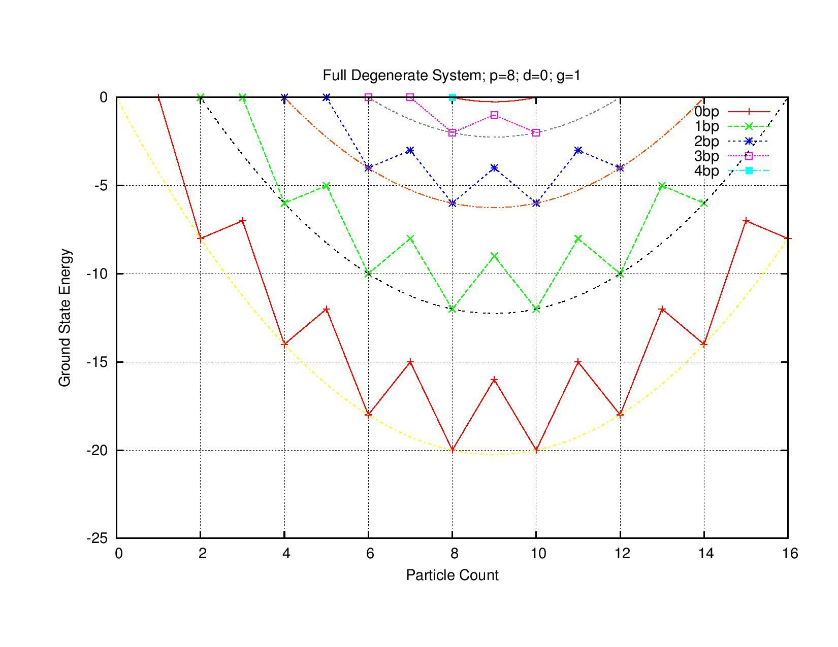
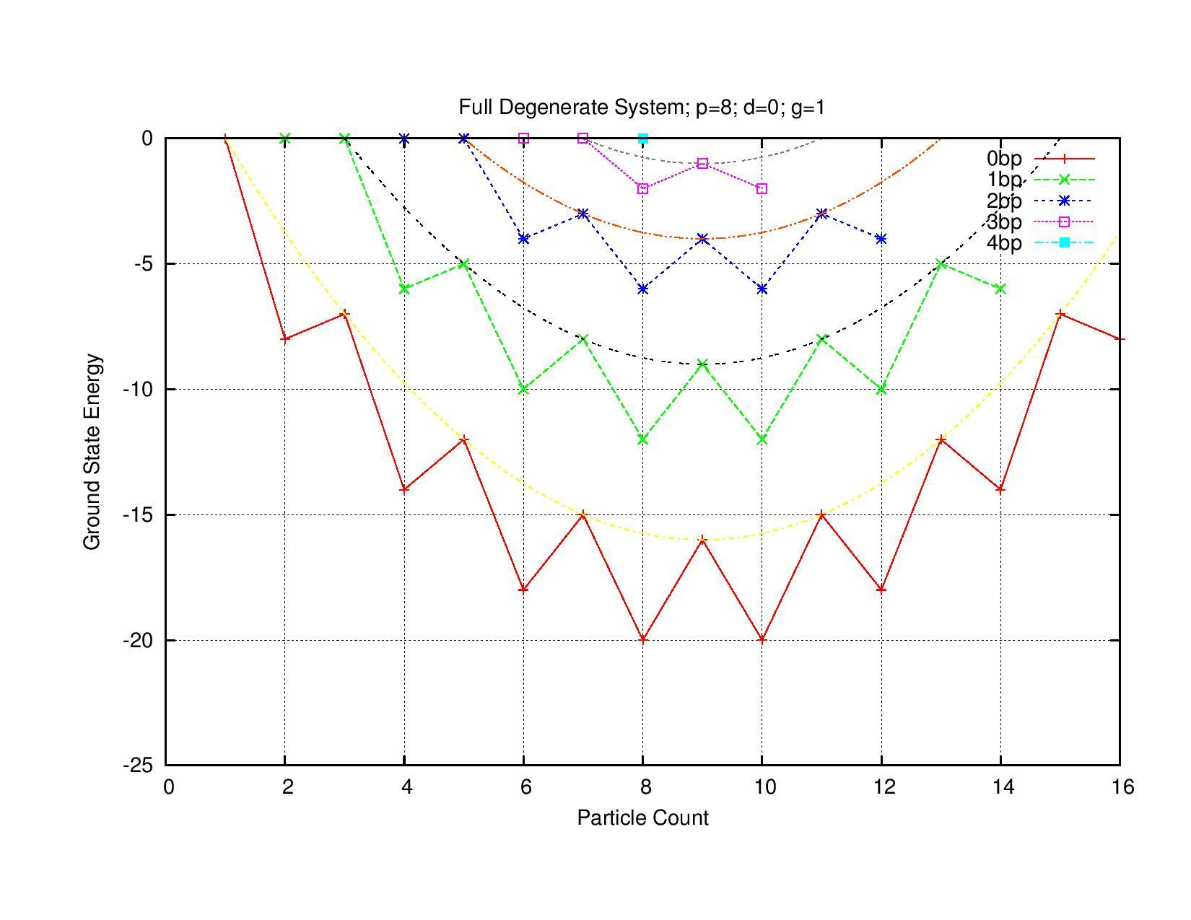
Tests against Exact Solutions
E₀ = -0.25g(n-2i)((Ω - 4i) - (n-2i) + 2) E₀ = -0.25g(n-1-2i)((Ω - 2 - 4i) - (n-1-2i) + 2)

Slide 15
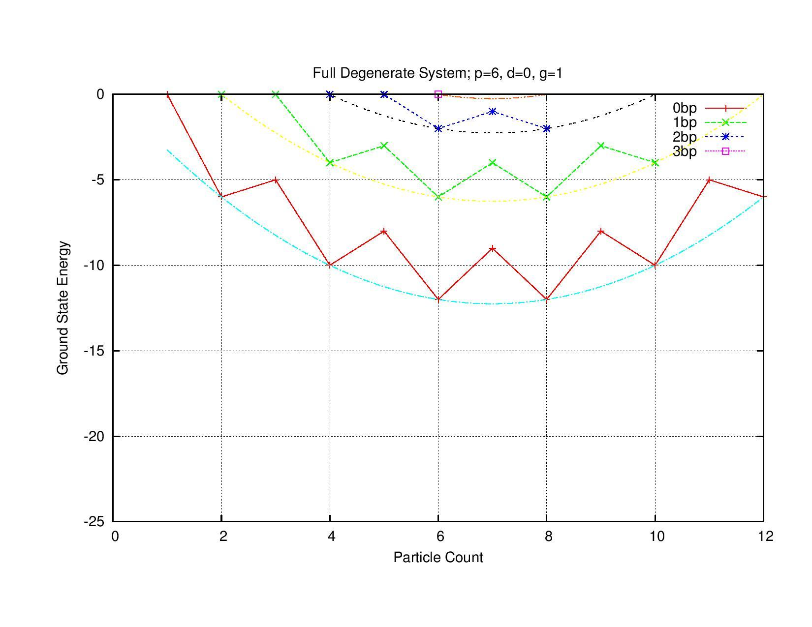
Tests against Exact Solutions

Slide 16
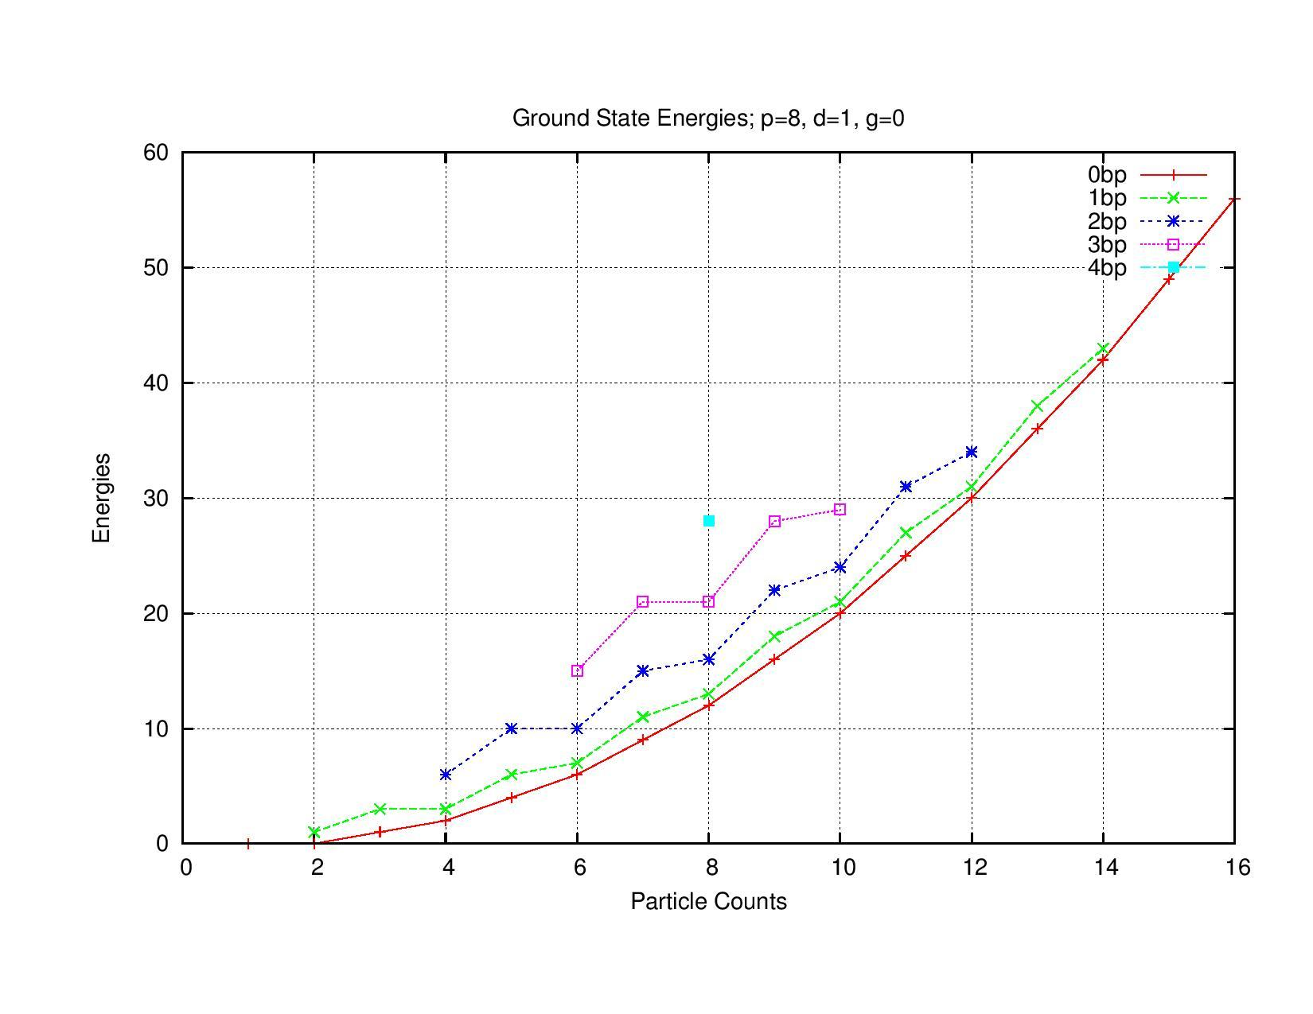
Results
No Attraction
system unbound
note differences between each case

Slide 17
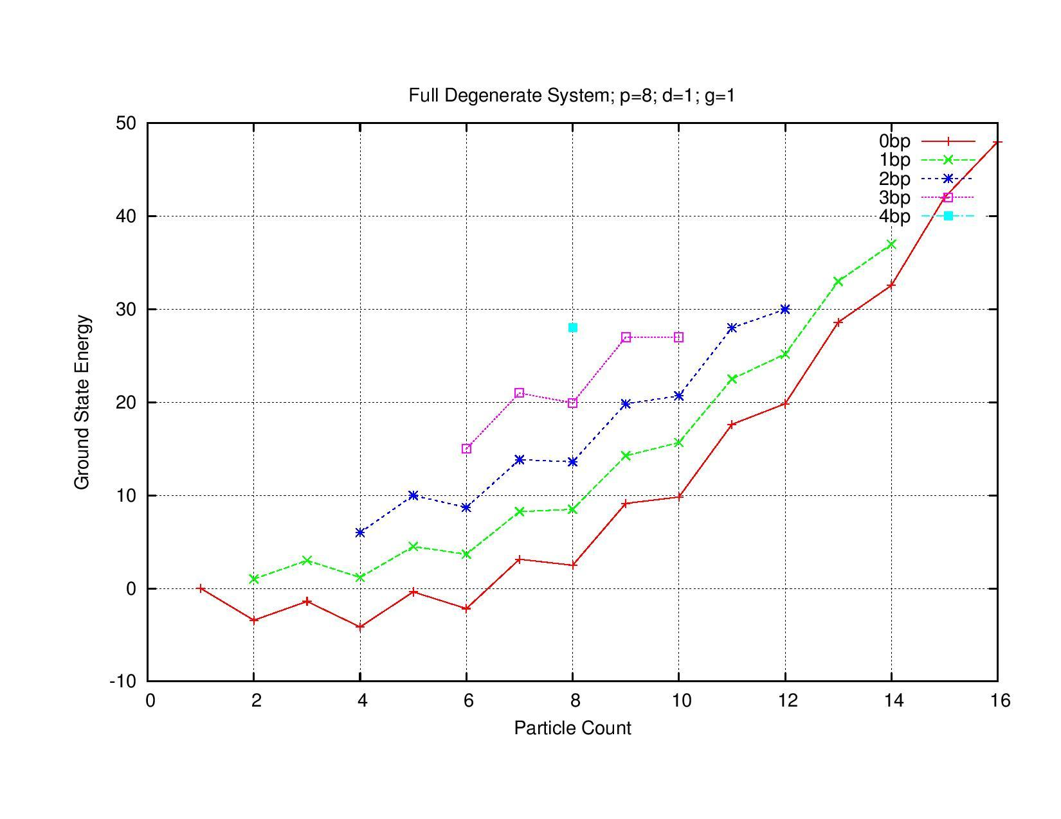
Results
Equal Weighting
SP outpace Pair attraction
Very few bound states

Slide 18
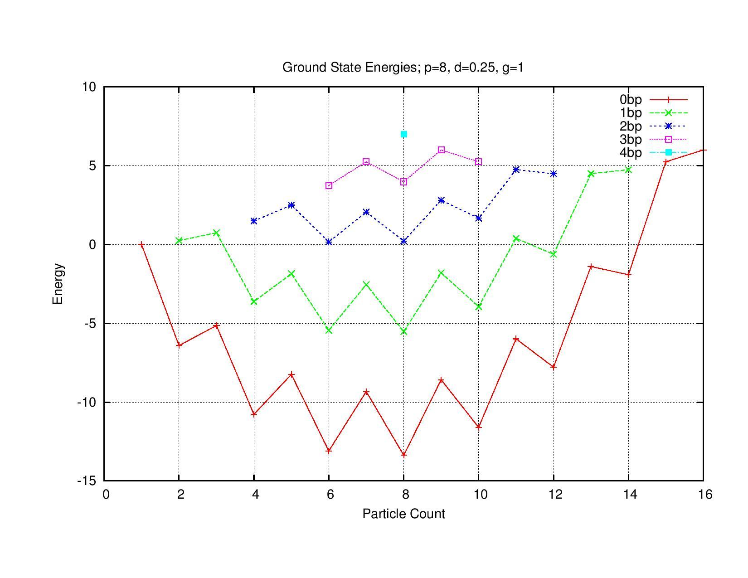
Results
Strong Attraction
Approaches full degeneracy
Many more bound states

Slide 19
Results
I was able to create a simple pairing model given the addition of an attractive pair exchange term to the single particle hamiltonian. From investigation of the hamiltonian, it is able to be formed as block-diagonal. This aids in both computational efficiency and in understanding which states are mixed.
The pairing term contributes in keeping a bound system, but it is only able to compensate to a point, especially as the number of particles approach the number of available states.

Slide 20
Future Developments
Increasing computation efficiency
Increasing allowed degeneracy of each level
Allow for differing degeneracy

Slide 21
Thank you for listening

Slide 22
References
M. Hjorth-Jensen. Nuclear Structure, lecture notes spring 2016. Department of Physics, Michigan State University, 2016.
https://github.com/johnbower2012/PHY981_work/tree/master/project3

